Slide 1
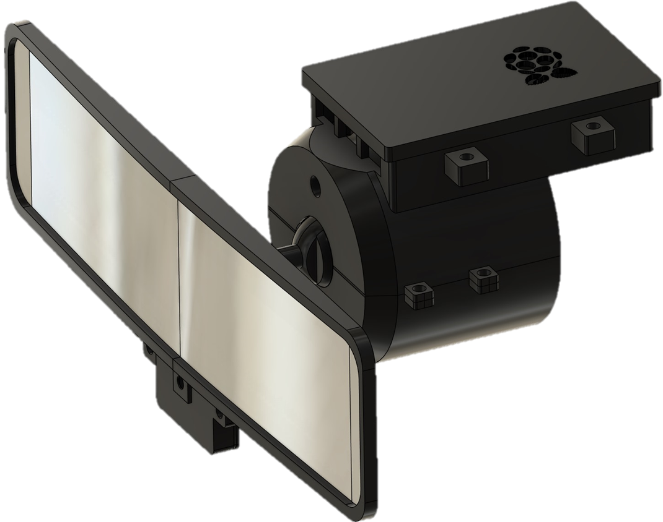
AUTOMATIC REAR-VIEW MIRROR
By: Diego Andrade, Valentina Clavijo, Kyuung (Casey) Cha, Nigel Ng, Mohammad Rahman
PROFESSOR: ALEX BLINDER | COURSE: ECET 400 | DATE: DECEMBER 2, 2024
Notes:
: Good evening everyone. To start off. We are automatic rear view mirror team.

Slide 2





Project Team
Diego Andrade
Valentina Clavijo
Kyuung (Casey) Cha
Nigel Ng
Mohammad Rahman
Born and raised in Ecuador until the age of 10, then moved to the United States.
Began college at NJIT in 2020, pursuing an Electrical and Computer Engineering Technology.
Interests: Power generation & distribution, control systems, automation, robotics, and renewable energy.
Born in Colombia, studied Mechatronics Engineering for two years and earned a technical degree in Mechatronics.
Began a bachelor’s degree in Electrical and Computer Engineering Technology at NJIT in 2022.
Interests: Control systems, automation, robotics, and power systems.
International South Korean software developer and recent retiree from the Korean military.
Currently pursuing Electrical and Computer Engineering Technology and Game Development at NJIT.
Interests: software development, video games, and computer graphics.
Born and raised American Chinese Test Engineer currently working at Cygnus LLC.
Began studying at NJIT after transferring from ECC in 2021.
Interests: Renewable energy, alternative transportation and traveling.
Born and raised in Kuwait till age 16 moved during my high school years and always aspired to be an engineer. Although mechanical at first.
Came in NJIT during covid and Switched major from general engineering to ECET around a year later.
Interests: Embedded systems, and Integrated circuits.
Notes:
My name is Valentina Clavijo (each member say name)

Slide 3
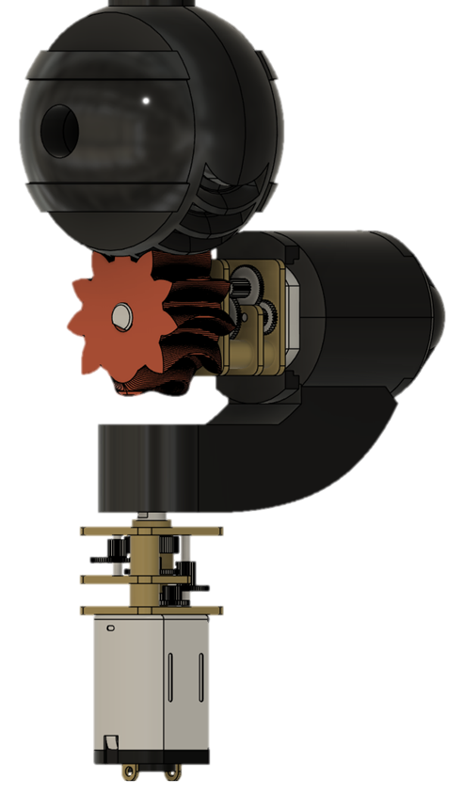
Objectives
Problem Statement
Issue Data
Concept
Related Patents
Prototype Mechanism
Concept flowchart
Block Diagrams
Final Prototype Requirements
Software
Hardware
Embedded Systems
Prototype Designs
Test deliverables
Specifications
Costs
Challenges Encountered
Starting Over
Enhancements
Acknowledgments
Questions from the audience
Demonstration
References
Notes:
these are the objectives that we have covered through the development of our project.

Slide 4


Problem Statement
Rise in car sharing
Allied Market Research states Car-sharing services are on the rise.
National Household Travel Survey reports the average car per household is below 2.0.
Increase in car sharing → Different Driver → Frequent Rear-View Mirror Adjustment
Issues
Mirror adjustments can be tedious and easy to overlook.
Mid-drive adjustment or incorrect adjustment can lead to accidents.
▲Allied Market Research. (2024). Car sharing market by service type, vehicle type, and application: Global opportunity analysis and industry forecast, 2023-2032.
▲National Household Travel Survey. (2022). 2022 National Household Travel Survey summary of travel trends.
Notes:
To start, it is important to mention that car-sharing services are becoming increasingly popular. According to Allied Market Research, the industry continues to grow every year, providing convenient transportation options for millions of users. Additionally, the National Household Travel Survey reports that the average number of cars per household has dropped below two, further highlighting the shift toward shared mobility.
While car sharing offers many benefits, it introduces a unique challenge: frequent driver changes lead to frequent adjustments of the rear-view mirror. Unfortunately, this seemingly simple task can be both tedious and easy to overlook.
If a driver forgets or improperly adjusts the mirror, it can compromise visibility and increase the risk of accidents. Attempting mid-drive adjustments only adds to this danger, as it distracts the driver from the road.
Our project aims to address this problem by developing a solution that ensures proper rear-view mirror adjustment, enhancing safety for car-sharing users and drivers alike.

Slide 5
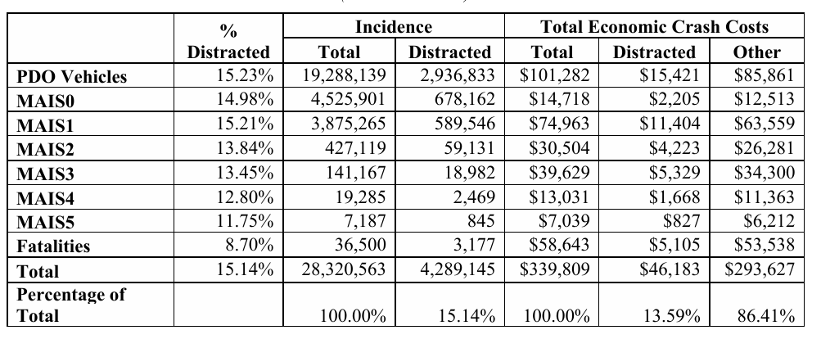
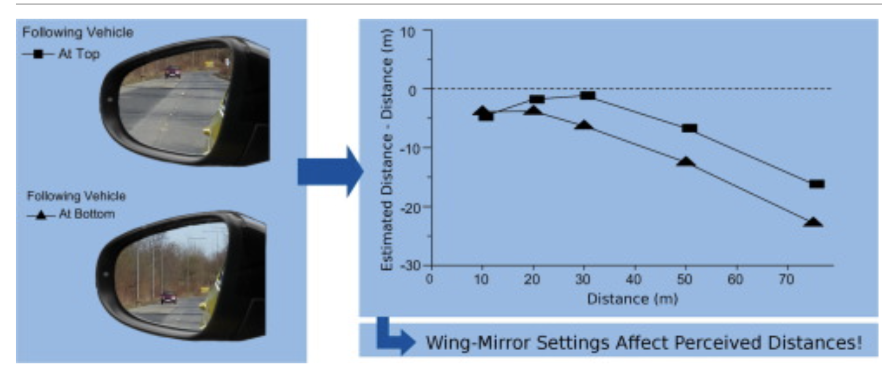
Issue Data
Accidents caused by distraction
Importance of precise mirror adjustment
▲F., Klauer, S., The economic and societal impact of motor vehicle crashes, 2019 (Revised) (Report No. DOT HS 813 403). National Highway Traffic Safety Administration.
▲”Designing a User-Centric In-Car Interface: A Case Study on Rear-View Mirror Adjustment." Transportation Research Part F: Traffic Psychology and Behaviour, vol. 38, 2015,
Notes:
MAIS1, which represents minor injuries. The data shows that there were 589,546 incidents caused by distracted driving within this category. These incidents resulted in a staggering $11.4 billion in economic costs.
This highlights how even seemingly minor injuries can have a significant financial impact when distraction is involved, emphasizing the need for solutions that improve driver focus and safety.
Based on the adjustment for your mirror, you can perceive the distance different. It costs 9% of the total traffic accidents

Slide 6
Concept for Automatic Rear-View Mirror
Eye Tracking through Computer Vision
Develop a system that automatically adjusts the rear-view mirror to the optimal position, ensuring improved driver convenience, safety, and adaptability to individual preferences or conditions.
3 Dimensionally Adjustable Ball-Joint Motor
Key features
Powered by Raspberry Pi
Optional Auto / Manual mode
Notes:
Our goal is to develop a system that automatically adjusts the rear-view mirror to its optimal position. This innovation is designed to improve driver convenience, safety, and adaptability to individual preferences or conditions.
Key Features:
Eye Tracking through Computer Vision: The system will utilize computer vision to track the driver's eye position and adjust the mirror accordingly.
3-Dimensionally Adjustable Ball-Joint Motor: A motorized mechanism allows precise adjustments across three dimensions for maximum flexibility and accuracy.
Powered by Raspberry Pi: The entire system is operated using a Raspberry Pi, providing a robust and efficient processing unit to enhance performance.
Optional Auto/Manual Mode: The system includes both automatic and manual adjustment modes, giving drivers the flexibility to choose their preferred method of control.
This design ensures a tailored driving experience, enhancing safety by eliminating distractions caused by manual mirror adjustments while providing cutting-edge technology for modern vehicles.

Slide 7
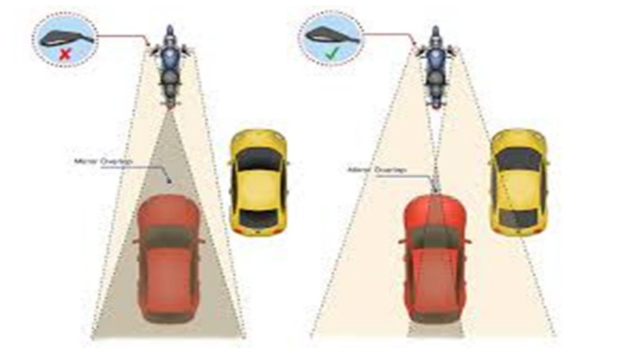
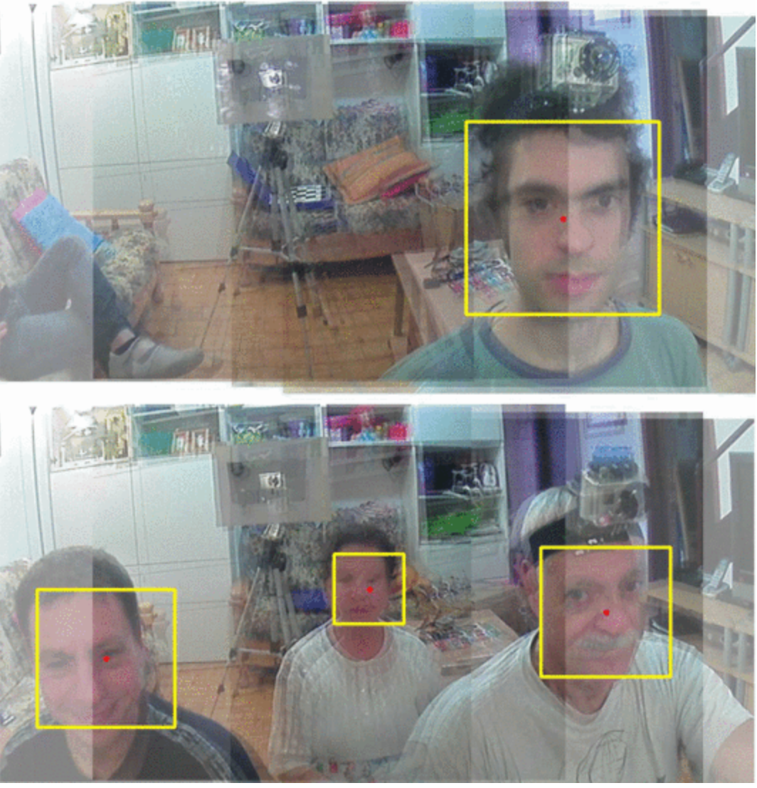
Related Patents
Vishwakarma Institute of Technology
Developed an automatic rear-view mirror for bikes.
Mirror angle was adjusted based on vehicle visibility.
Tongmyong University
Explored the eye-tracking technology’s potential for rear-view mirror adjustment to improve driver safety.
Only conceptualized.
University of Bologna
Created a prototype of motor adjustment through face tracking.
Used Windows as main operating system.
▲Karvir, S. (2023). Automatic Adjustable Rear-View Mirror Using Servo Motor and Arduino for Bikes
▲Rota, F., & Stefano, L. (2017). Automatically adjustable rear mirror based on computer vision. 2017 International Conference of Electrical and Electronic Technologies for Automotive, 1-7
Notes:
There are some related research and patents:
Vishwakarma Institute of Technology: This team developed an automatic rear-view mirror system for bikes, where the mirror angle was dynamically adjusted based on the vehicle's visibility.
Tongmyong University: Researchers here explored the potential of eye-tracking technology for rear-view mirror adjustments, aiming to enhance driver safety. However, their work remained at the conceptual stage without a physical prototype.
University of Bologna: They created a working prototype that used face-tracking technology to adjust the mirror's angle. The system was built with Windows as the primary operating system, demonstrating a practical approach to mirror automation.
These developments highlight a growing interest in driver-centric mirror adjustment systems, setting the stage for innovative solutions that improve safety and convenience in both vehicles and bikes.

Slide 8
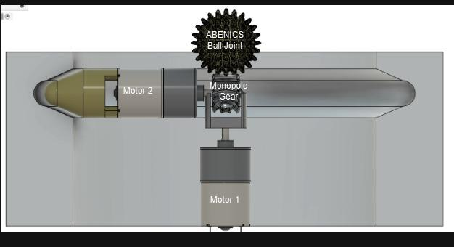
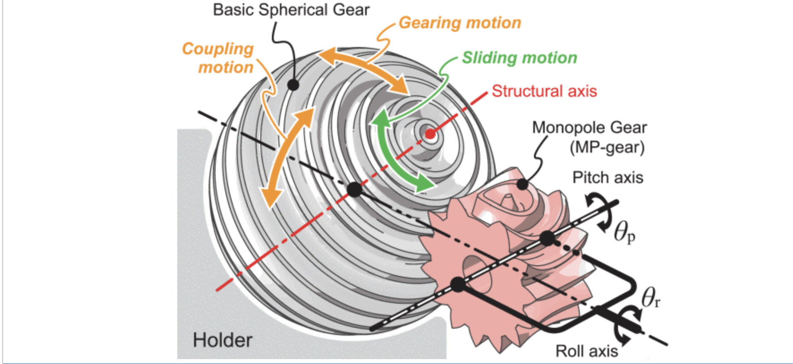
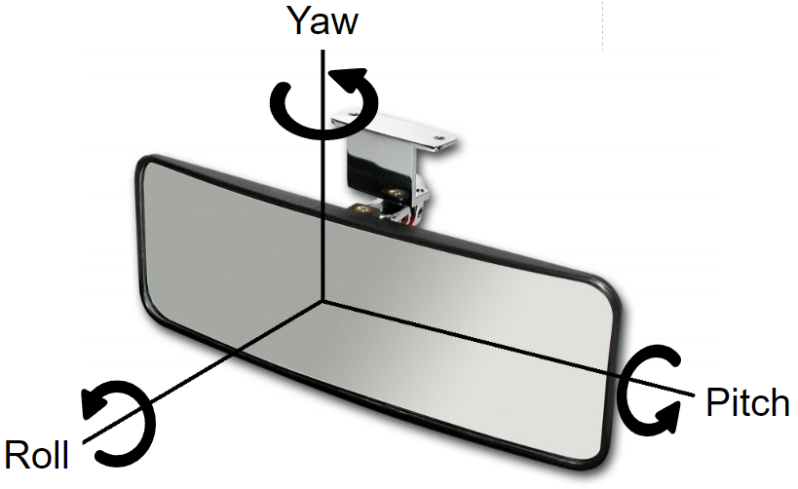
Prototype Mechanism
ABENICS ball joint is crucial for the main operation of the system.
Multidirectional axial movements: yaw and roll.
Gruebler’s equation is used to find the degrees of freedom.
Adjustments are made to the rear view mirror through data collected from the camera.
The rear-view mirror is adjusted and held in place via a connection with an ABENICS Ball joint and a monopole gear.
The yaw and roll of the ball joint is controlled by two DC motors, where Motor 1 controls the roll and Motor 2 controls the yaw.
Notes:
Motor 1 controls the roll and Motor 2 controls the yaw.

Slide 9
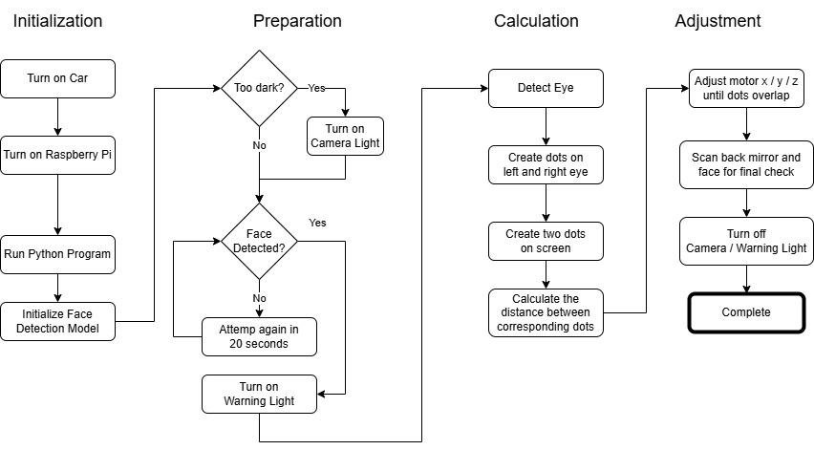
Concept Flowchart
Initialization
Preparation
Calculation
Adjustment

Slide 10
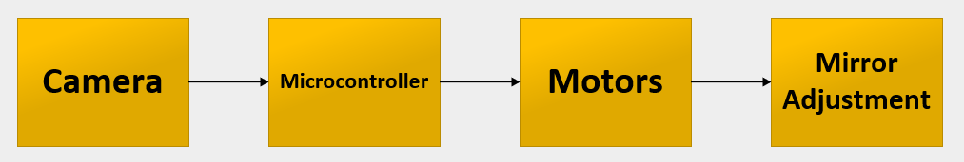
Top Level Block Diagram
Notes:
The key system components for what needed to be focused on first as planning, designing and testing began.
Camera Block - The camera block is the central feature for our product as it is the primary selling point, allowing drivers quick and easy adjustment to their rear-view mirror when the camera scans and detects the driver’s eye level when powered on.
Microcontroller Block - The microcontroller block focuses on utilizing embedded systems to enable control over the DC motors either through manual or automatic operation in addition to other components. Manual operation via a directional pad and push button controls with a USB connected controller. Meanwhile, automatic operation via data received from the camera and eye tracking software to enable the DC motors to move the mirror.
Motors Block - The motors block is about how the DC motors will work to adjust the angle of the rear-view mirror. With the use of a monopole gear attached to one of the motors, labeled as motor 2, acts to change the pitch and yaw of the rear-view mirror when it’s attached to the ABENICS Ball Joint. While the other DC motor, marked as motor 1 is used to control the roll for the components connected to its drive shaft.
Mirror Adjustment Block - The mirror adjustment block directly relates to the motors block, where the previous block describes the DC motor’s functionality, this block describes how the adjustments will be made towards the rear-view mirror. The data received from the microcontroller begins to activate the motors to first adjust the pitch & yaw of the rear-view mirror in a drastic adjustment depending on the eye level of the driver, then adjust the roll with motor 1.

Slide 11
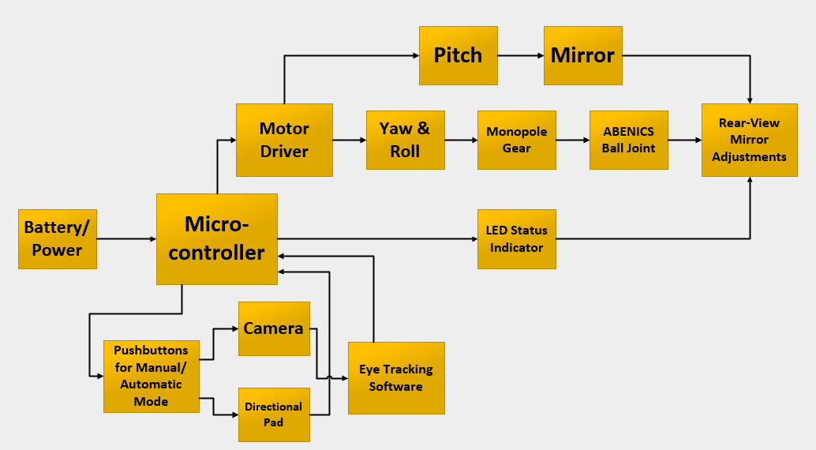
Second Level Block Diagram
Notes:
The first block of the second level block diagram is dedicated to power sources, in which we used a power adaptor and a 9V battery to source power for components, where in the future power would be sourced from the battery of a motor vehicle for mass production.
The microcontroller section is where data is retrieved from the camera to be processed and activates the motors to move both the monopole gear and ball joint to adjust the rear-view mirror.
The pushbuttons block is how the driver will switch between automatic and manual operation modes. Manual operation is associated with the use of the directional pad to make additional adjustments. While automatic operation ties in directly to the camera, to have visual of the driver’s face and the eye tracking software block focuses on gathering the data when locating the eye level of the driver.
The LED status indicator is to notify the driver that automatic adjustments are being made when set to automatic mode or when previously set to automatic mode the driver turns on the vehicle.
Motor driver block is about the chip used to assist in control of the DC motors, to allow operation at lower voltage when a separate power supply is inputted. Yaw & roll, known as the Z- axis and X-axis, are associated with motor two, whereas pitch is associated with the Y-axis and motor one. This area is how we planned for the motors to be positioned to make adjustments. Finally, the monopole gear & ball joint blocks are about the gear system used to offer smooth movement to change the angle of the rear-view mirror.

Slide 12

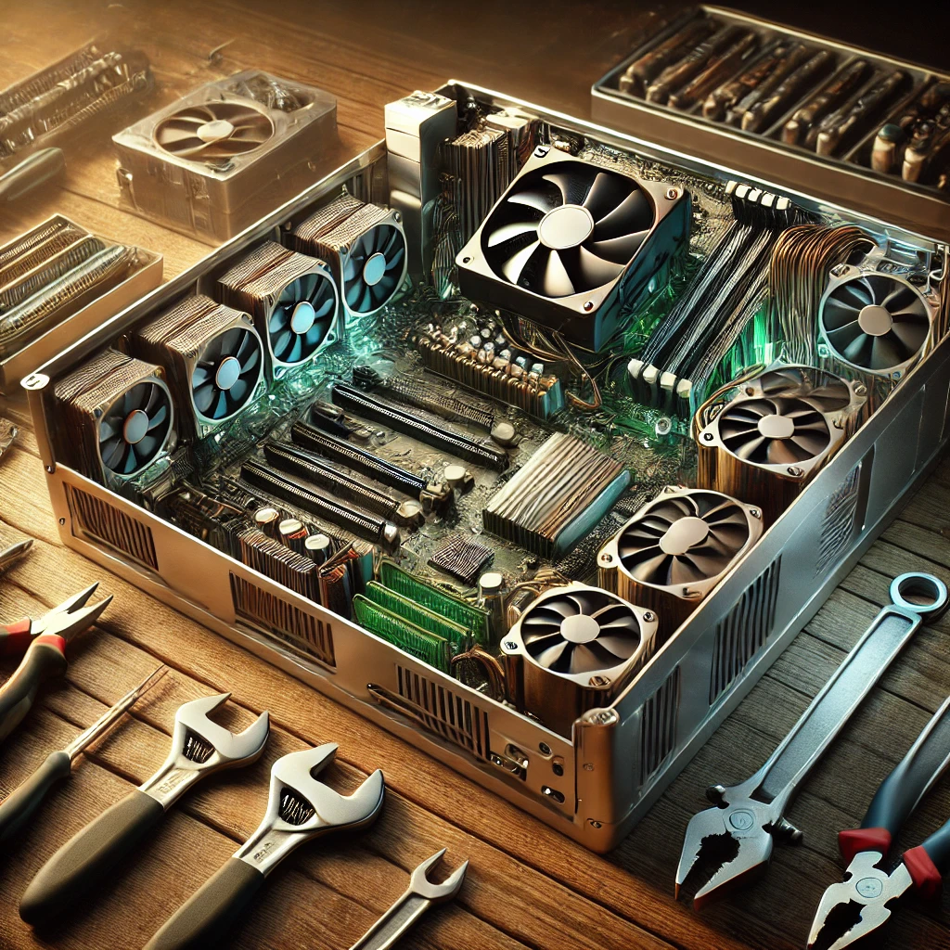
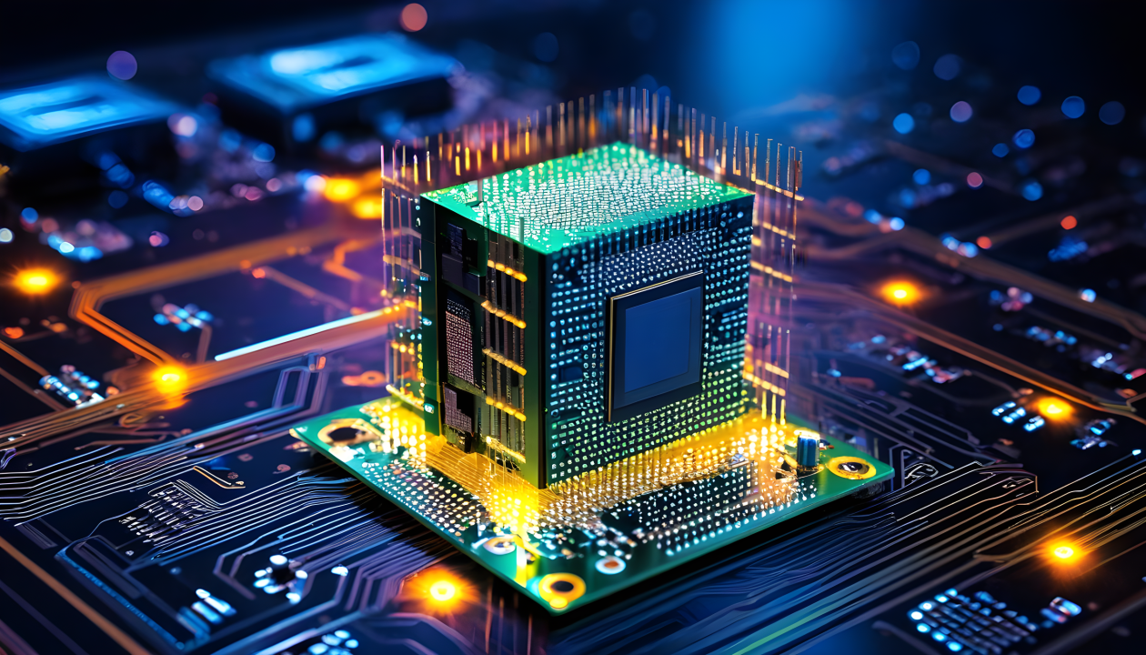
Final Prototype Requirements
Software
Hardware
Embedded Systems
Notes:
Final prototype requirements is what was necessary in terms of milestones for us to achieve for the software, hardware, and embedded systems. Software being to have the eye tracking work properly scanning and capturing the driver’s face. Hardware would be providing voltage to everywhere necessary, thus allowing the embedded systems to work through the various inputs, outputs, and indicators.

Slide 13
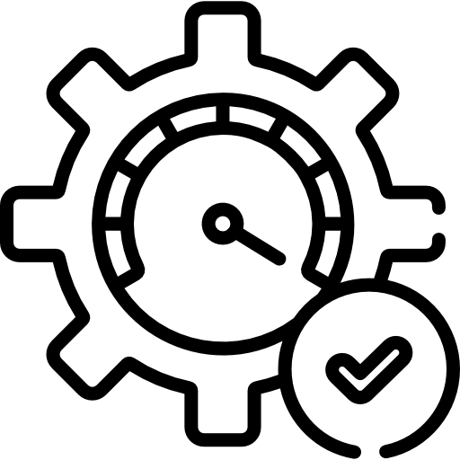





Software Overview
Summary
Python: main programming language
MediaPipe: computer vision library
OpenCV: video capturing
PyGame: controller input
Functionality
Capture driver’s eye coordinates
↓
Measure the distance between driver’s eyes and predefined location
↓
Calculate the required angle adjustment flow
↓
Signal motor functions in sequence
↓
Scan the result
Key focus
Optimization to run on Pi’s limited hardware
Offline functionality for Data Privacy

Slide 14
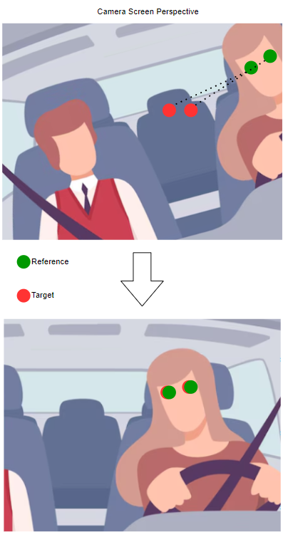
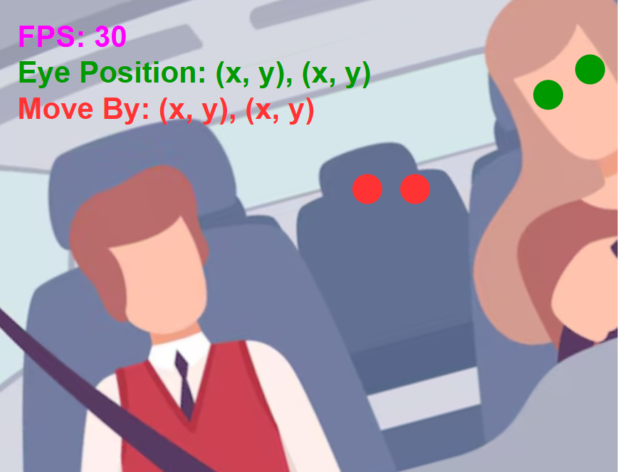
Adjustment Process Example
Camera’s perspective

Slide 15
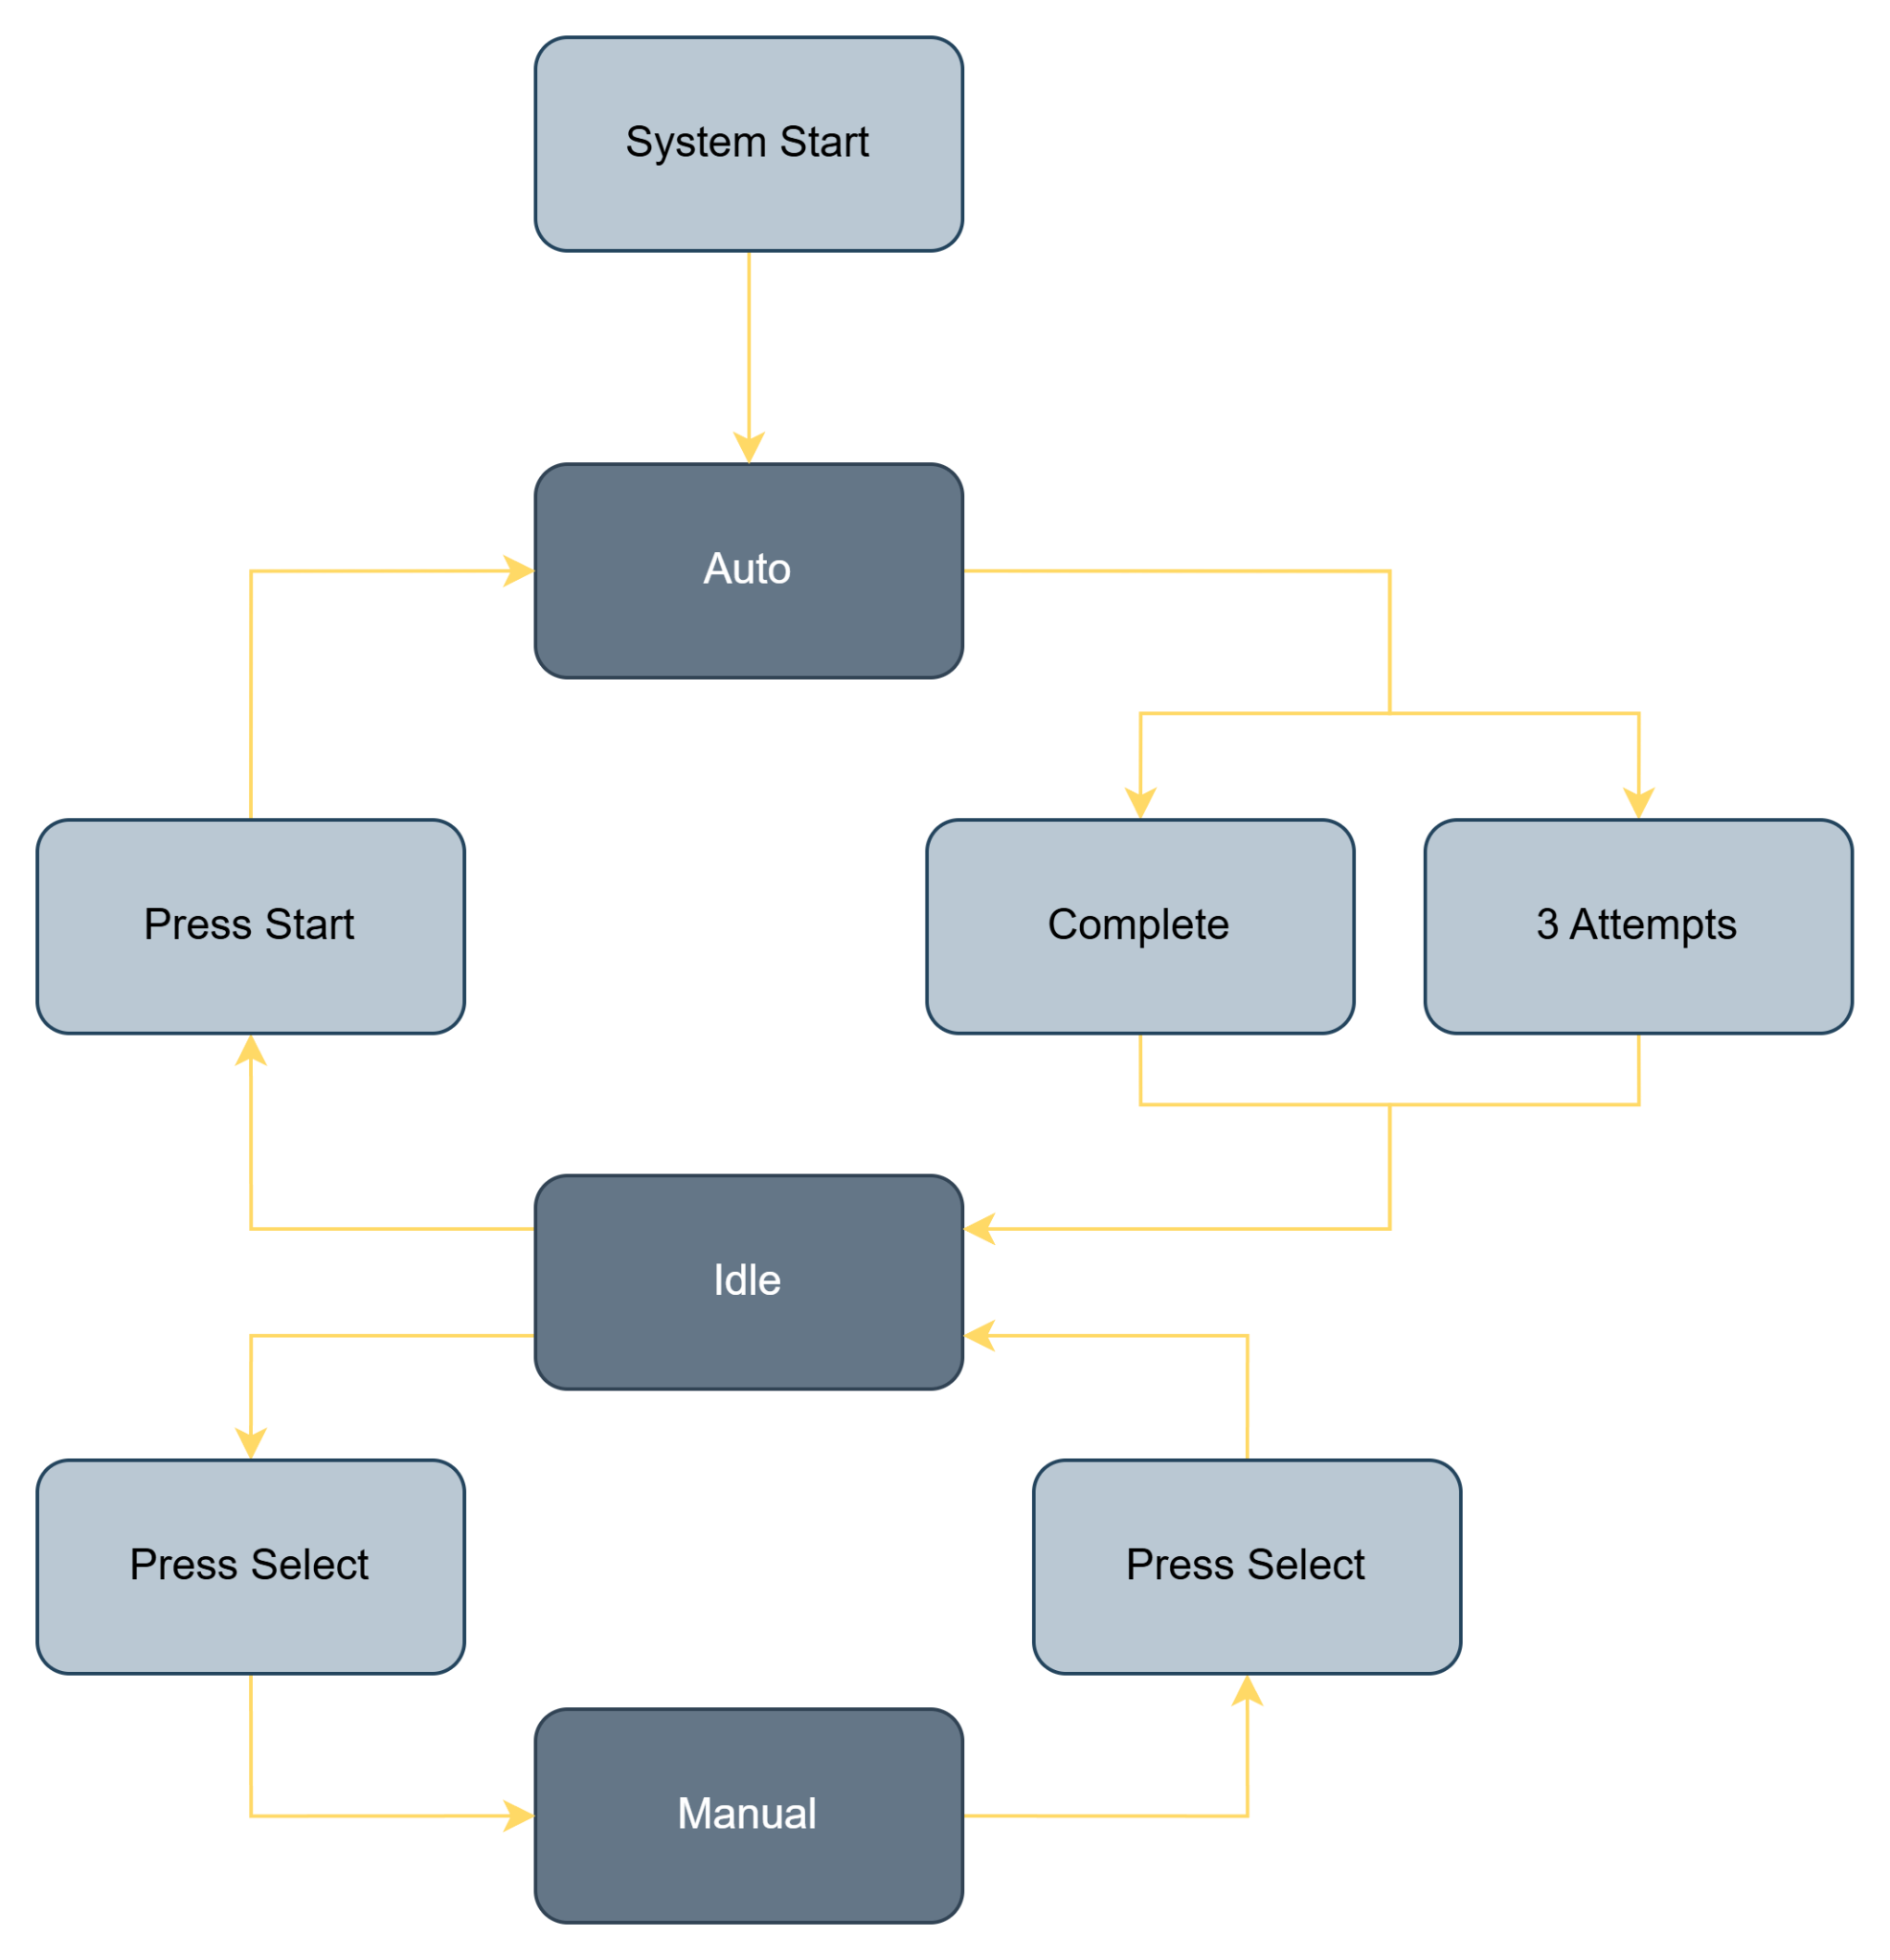
Software State Machine

Slide 16
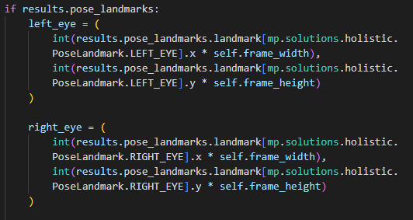
EyeTracking.py
Retrieve camera input using OpenCV
Process the input through the MediaPipe Holistic model
On face landmark detection, map left and right eye coordinates based on screen frame size

Slide 17
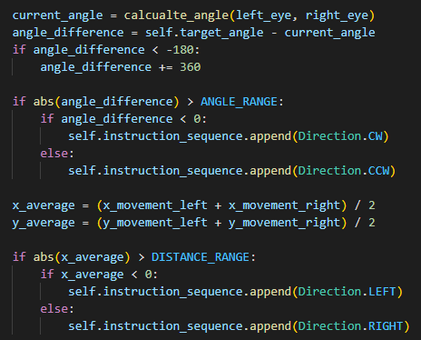
EyeTracking.py
Compare the distance and the angle between the mapped eye position and the target position
Retrieve the necessary adjustments to create the instruction sequence

Slide 18
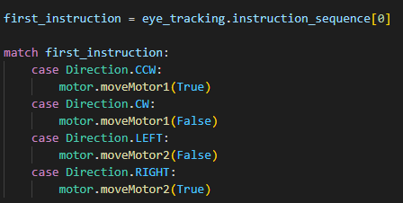
EyeTracking.py
Adjust the specified motor based on the instruction in order
Once instruction sequence is empty, adjustment is complete

Slide 19
Hardware Components
Raspberry Pi Model 4 Microcontroller
DC Motor Set - Micro Gear Motor 6V Mini Gearbox
Directional Pad
3D Printer Filament
Rear-view mirror
Motor Driver L293D
Battery 9V
Camera C950
Pack of Pilot Lights
Breadboard
Wires
Notes:
These are the hardware components used to resolve all the functions reserved for the project. Where the main components were described earlier in the first level block diagram, that being the microcontroller, USB connected web camera, and DC motors. The additional hardware makes up the main bulk of the project allowing everything to run properly. Wires serving as the main connections for each component, directional pad for manual control, 9V battery for power, motor driver to assist in control of DC motors, and 3D printer filament for the housing and moving parts used.

Slide 20
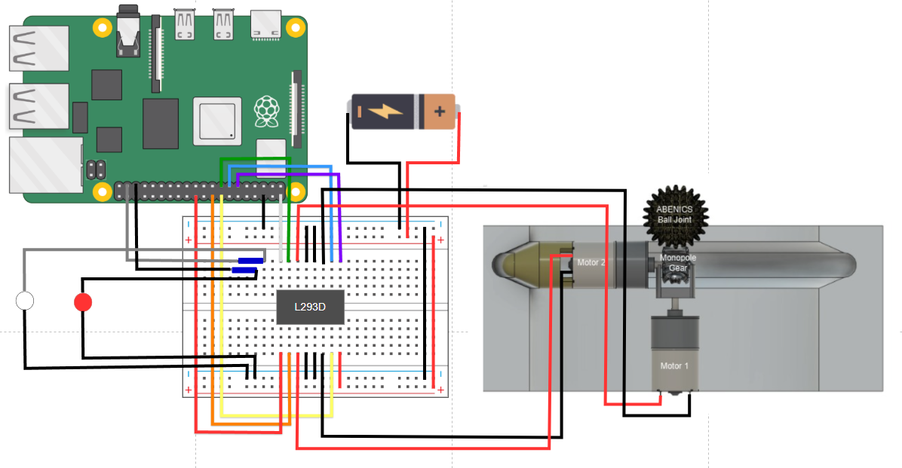
Embedded Systems
Notes:
This is the overview design for what the hardware circuit looks like, in which all the components are wired to the breadboard. With the Raspberry Pi connected at the GPIO at several points allowing connections and control over the components, such as the LEDs and the DC motors through L293D motor driver. As well as the 9V battery providing power to the driver allowing operation at the low voltage we’ll be using.

Slide 21
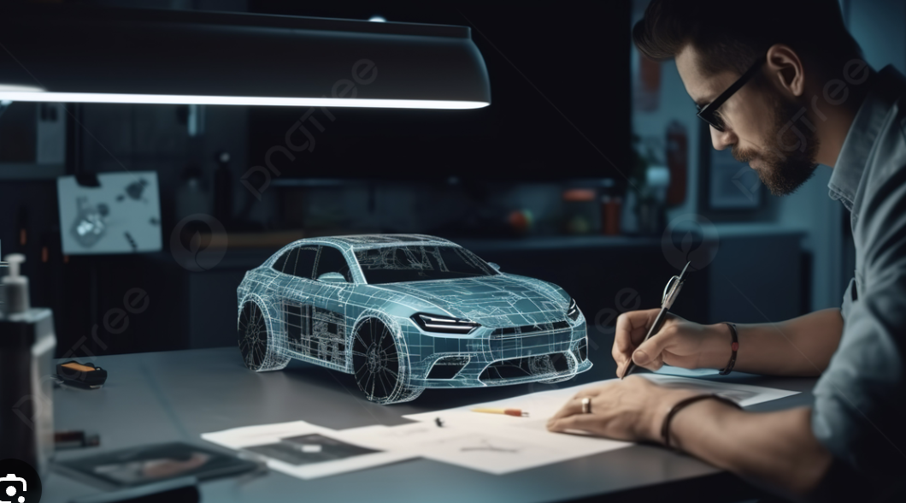
Prototype Designs

Slide 22
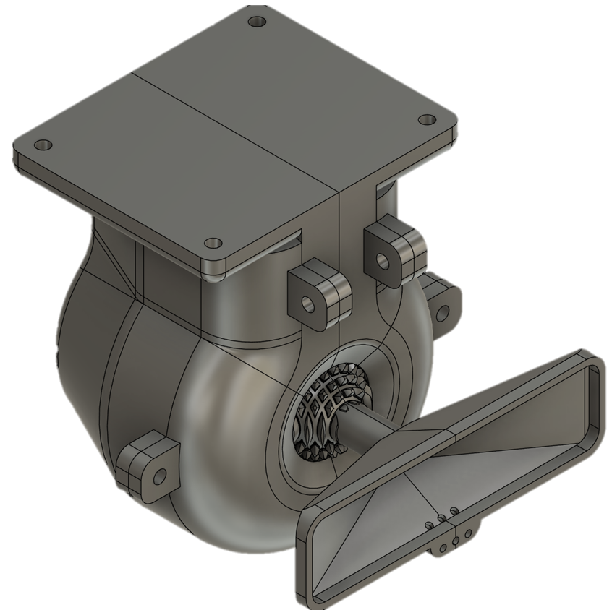
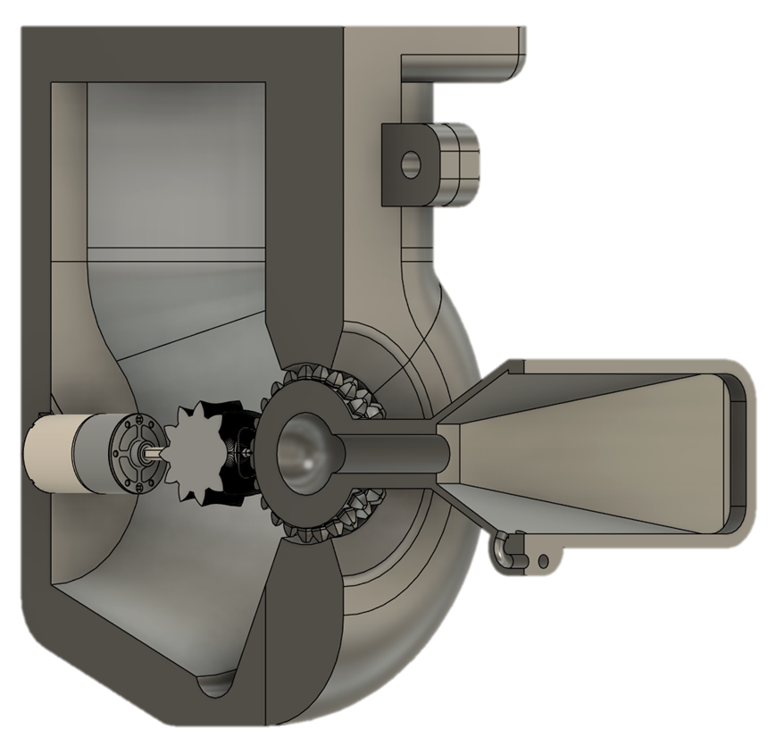
Concept Design

Slide 23

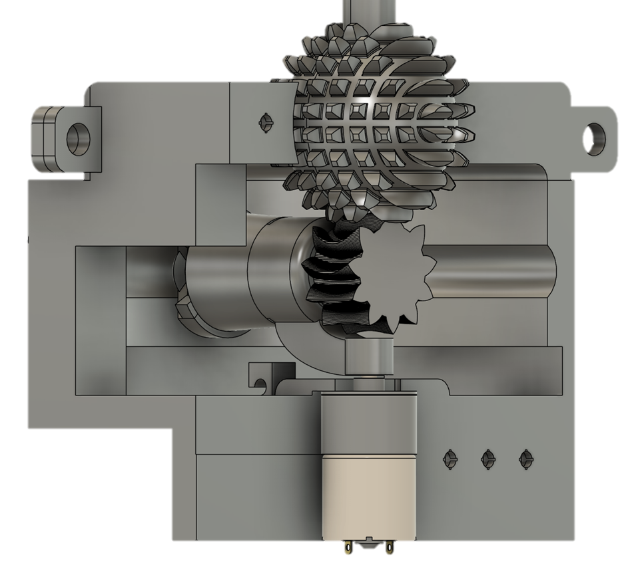


Motor Testing Design
Designed to test the motor rotation within the housing unit, with an open space left to observe the motor's movement while interacting with the housing.
Issue
3D Printed ABENICS Ball Joint was too loose within its housing
Issue
Difficult for Monopole gear to make contact with Ball Joint
Issue
Design is massive and inconvenient

Slide 24
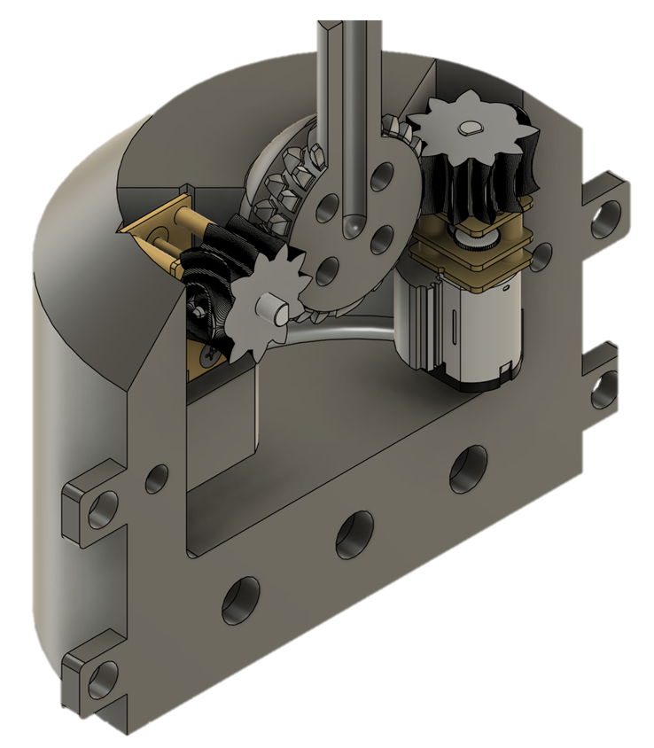
Stationary Motors Design
Designed to eliminate errors caused by the motors movement within the housing unit.
Issue
Monopole gear was not able to move along with the ball joint
Issue
Ball joint teeth would get stuck against housing unit
Issue
Unpredictable ball joint movement

Slide 25
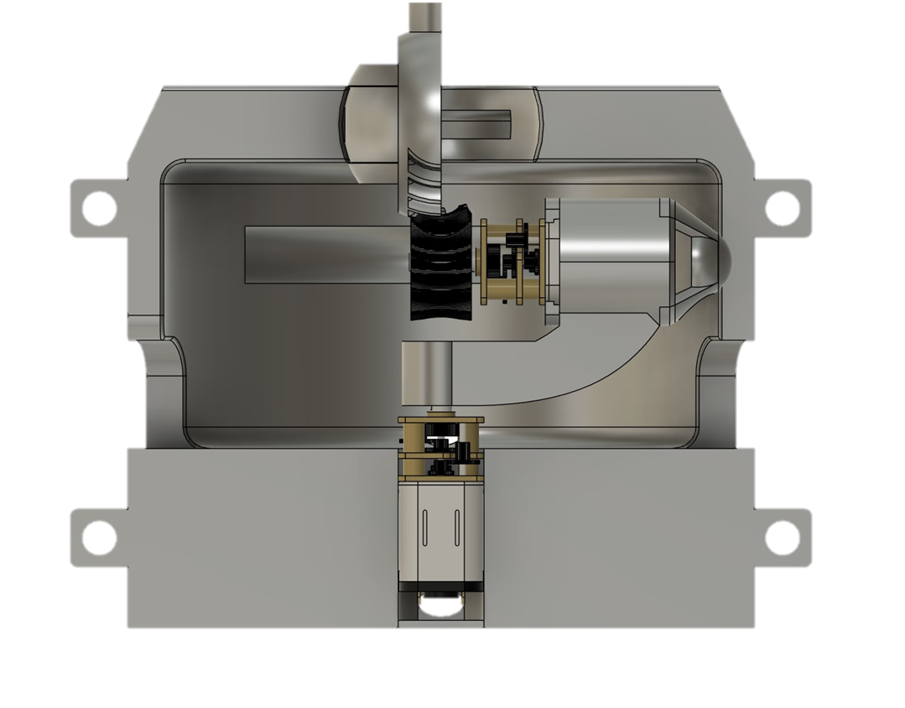
Working Prototype
Created using the concept design along with an updated ABENICS ball joint, specifically engineered to eliminate the pitch axis, which was identified as the most unstable.
Issue
A wiring issue caused wires to snag
Issue
Monopole gear jams if not properly positioned
Issue
The design does not include the housing for the Raspberry Pi

Slide 26

Embedded Systems Working Prototype

Slide 27
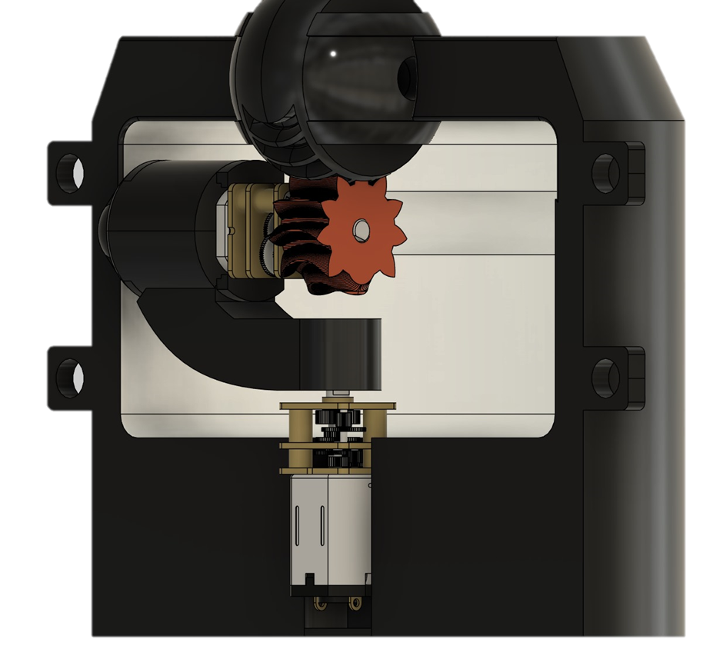
Final Prototype Design
13 / 20

Slide 28
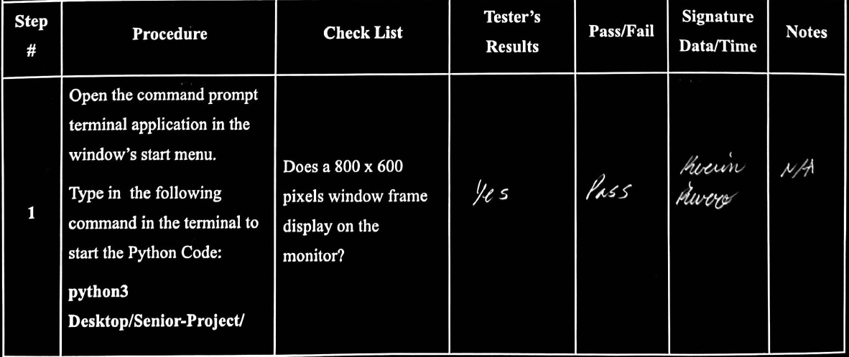
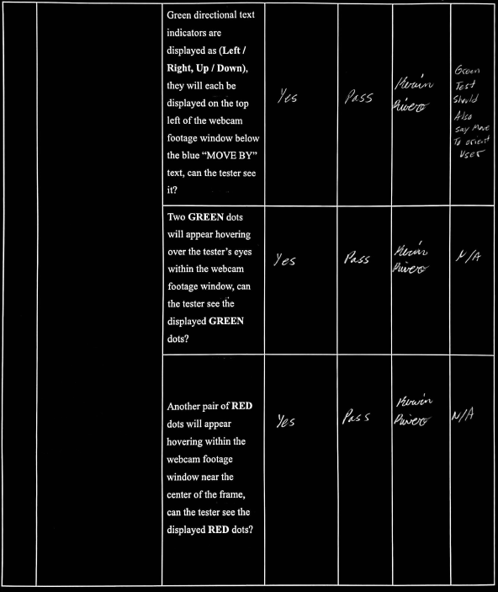
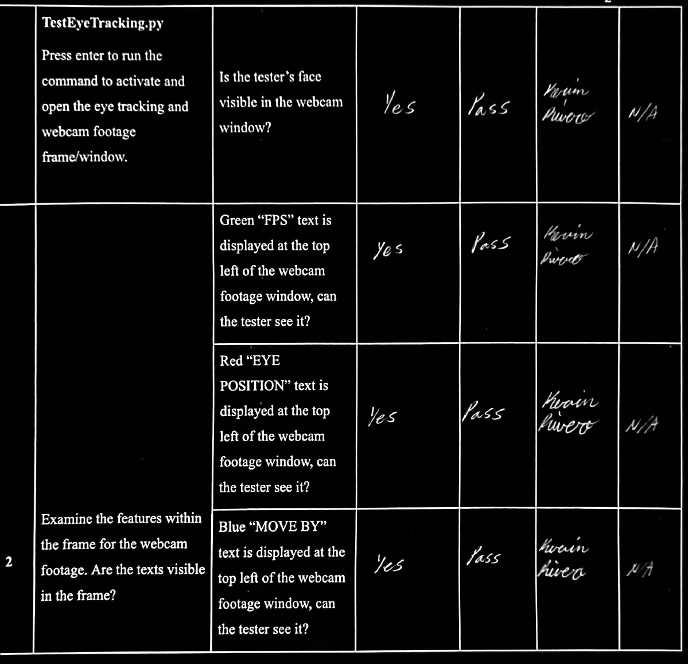
Testing Deliverable 1 Results

Slide 29
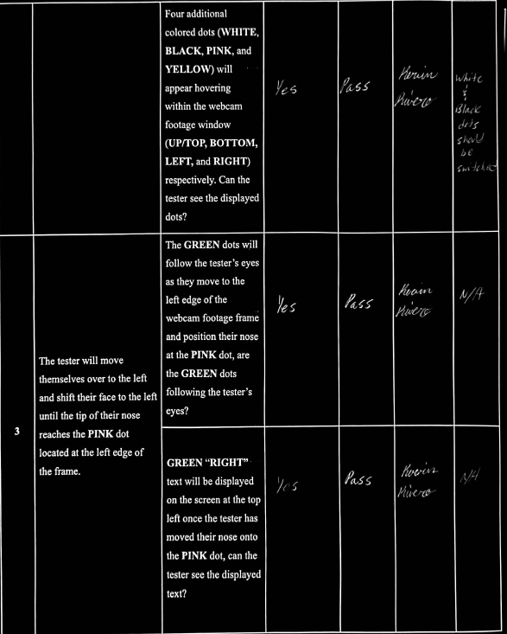
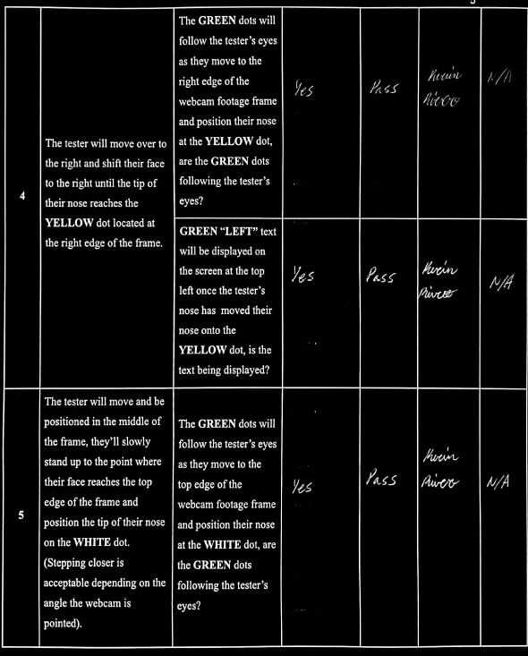
Testing Deliverable 1 Results Cont.

Slide 30
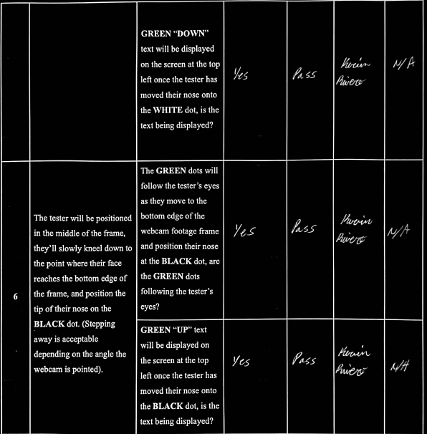
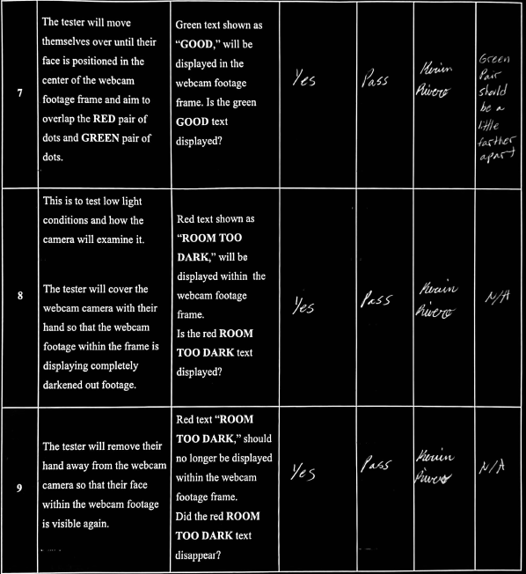
Testing Deliverable 1 Results Cont.

Slide 31
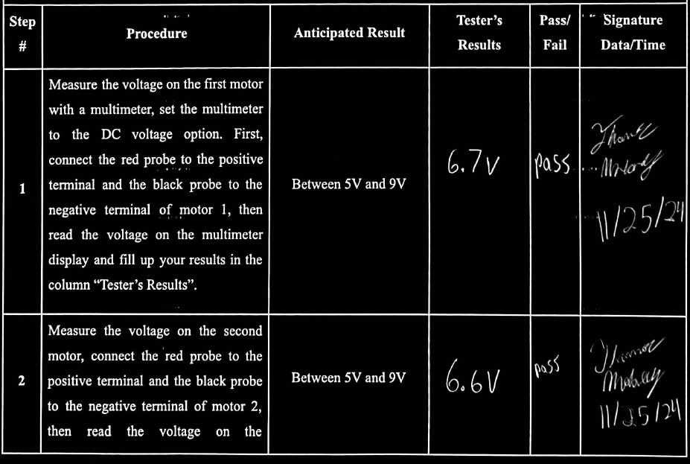
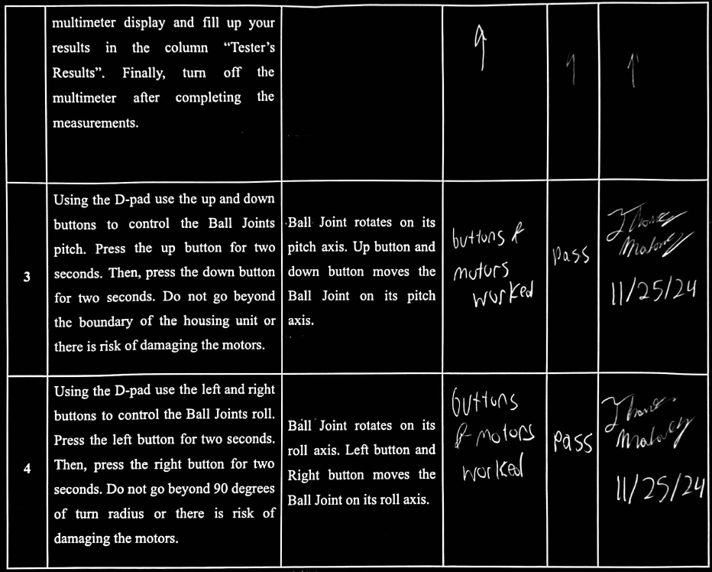
Testing Deliverable 2 Results.

Slide 32
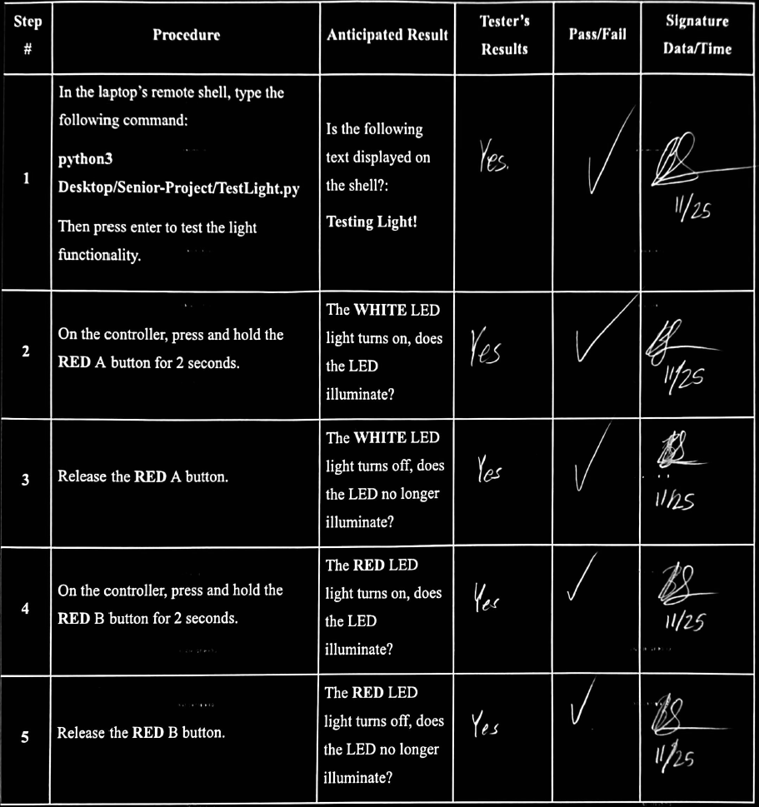
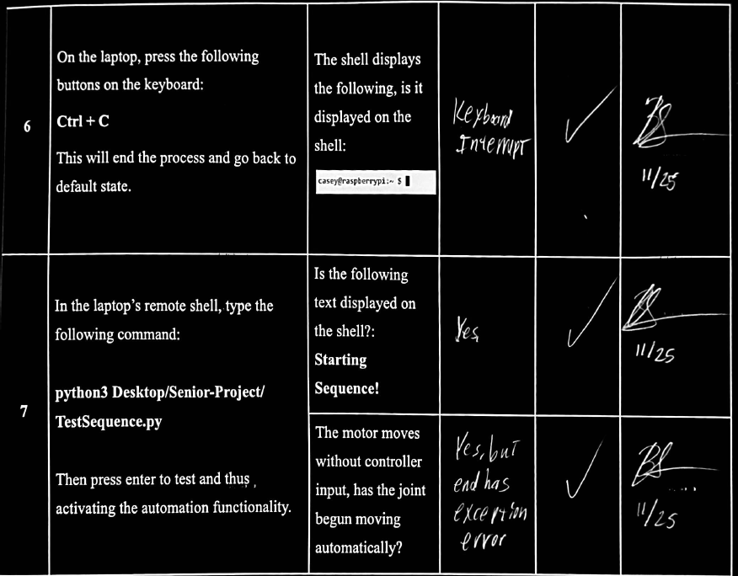
Testing Deliverable 3 Results.

Slide 33
Electrical Specifications
Power Supply:
9V Battery.
9V Power Supply.
3.3V and 5V from Raspberry Pi 4 GPIO.
Camera: 3.3V, 1080P @ 30 FPS.
Motor Driver: 4.5V - 36V @ 1.2A - 600mA.
DC Motors: 6V, 10W, @ 10 RPM.
Controller: 3.3V, USB Connected.
Microcontroller: 15W (@ 5V and ~3A), 64-bit processor, 4GB RAM, Gigabit Ethernet, and USB 3.0.
LEDs: 3mm, 3V @ 25mA.

Slide 34
Physical Specifications
Ball joint: Provides axial movement .
Raspberry Pi: Controls and processes data through the use of a camera module utilizing eye tracking software.
Directional pad: Manual adjustment.
Camera: Detects the driver's face and eyes to send input to microcontroller.
LED indicator:
Enables the camera to clearly capture the driver's face.
Alert the driver during adjustment.
Motor and motor driver:
Controls the monopole gear and the ABENICS ball joint.
Interface with the microcontroller to control and manage motor speed or direction.

Slide 35
Costs Towards Prototype
Component | Part Number | Description | Quantity | Cost Per Unit | Total Cost
Raspberry Pi | 4 model B | Pi 4 4GB Board Only | 1 | $55.00 | $55.00
Controller (D-pad) | Joystick Raspberry Pi | 2 Pack USB Wired Controller | 2 | $7.99 | $14.99
3D Printer Filament | N/A | 3D Printed ABENICS Ball Joint, Monopole Gear, Motor Housing, and Housing Unit | 17 hours | $1.00 per hour | $17.00
Rear-view mirror | BT-4MG9-2IM9 | Kitbest Rear View Mirror, Universal 11.4 Inch Interior Clip On Panoramic | 2 | $9.99 | $19.98
Motor Driver | L293D | L293D Stepper Push-Pull Motor Driver Controllers | 1 | $8.99 | $8.99
Battery | 9V Energizer max | 2 count MAX premium alkaline 9 volt. | 2 | $3.49 | $6.99

Slide 36
Costs Towards Prototype Cont.
Component | Part Number | Description | Quantity | Cost Per Unit | Total Cost
Camera | C950 | USB Webcam with Microphone & Physical Privacy Cover | 1 | $19.99 | $19.99
Pack of Pilot Lights | 3mm LED Lights | 250pcs (5 Colors x 50pcs) 3mm LED Light Emitting Diode Lamp | 1 | $4.99 | $4.99
Breadboard | 7545924028 | Breadboard Set Prototype Board - 6 PCS 400 Pin Solderless Board Kit | 1 pack of 3 | $7.99 | $7.99
Wires | EL-CP-004 | ELEGOO 120pcs Multicolored Dupont Wire Breadboard Jumper Ribbon Cables Kit | 1 | $6.98 | $6.98
DC Motor Set | a16010600ux0130 | Micro Gear Motor 10RPM DC 6V Mini Speed Reducer Gear Box | 2 | $9.99 | $19.98
TOTAL COST |  |  |  |  | $182.88

Slide 37
Mass Production
BEFORE
Embedded Systems
Raspberry Pi
BCM2711 - $25
4GB RAM - $20
Ports
4 USB - $4
2 HDMI - $5
Ethernet - $2
Power Supply - $5
Motor Driver - $1
Breadboard - $1
Mirror - $9
Housing - $5
Components
Monopole Gear - $2
ABENICS Ball Joint - $2
Motors - $10
Total - $63
AFTER
Dedicated Circuit Board
Alternative Chip
Ex) S905X3 - $10
4GB Ram - $20
Ports
2 USB - $2
Imbedded Motor Driver - $0
Imbedded Breadboard - $0
Mirror - $5
Housing - $3
Components
Monopole Gear - $0.50
ABENICS Ball Joint - $0.50
Motors - $8
Total - $49

Slide 38
Challenges Encountered
3D Printing/Design Errors
Motor Cap snapped at the stress lines.
Ball Joints came out deformed.
Difficulty assembling Housing Unit.
3D printed parts interface failed.
Inefficient printing time.
Raspberry Pi Camera Module Not Pairing
Camera Module failed to connect.
Solutions
Change physical measurements.
Reprint housing units using a different printing filament.
Use an advanced 3D printer.
Use a different camera reference.

Slide 39
Challenges Encountered Cont.
Raspberry Pi Short Circuit
Excessive current caused a short circuit
Due to the use of a high battery voltage source, the microcontroller was left damaged.
Revised Housing Design
Motor 1 area was too deep to allow screws to be inserted.
Hinge of motor 2 housing broke under pressure as motor 1 began rotating.
Unstable moving 3D printed parts.
Solutions
Use 9V battery to power L293D motor driver.
Use 9V battery to power the microcontroller.
Use the Raspberry Pi GPIO power to supply components.
Redesign housing unit.
Divots to account for close space within housing unit to fit components inside.
Extra holes and hooks to wiring from becoming jammed when DC motors activate.

Slide 40
Starting Over
Time Management
Reassessing priorities and timelines to optimize productivity.
A firm schedule ensures better allocation of time for critical tasks and reduces delays.
Design Implementation
Outreach
Rebuilding the foundation with improved concepts and strategies.
Revisiting the design process allows for addressing past issues, enhancing functionality, and ensuring a seamless outcome
Engaging industry professionals and companies for guidance and resources.
Leverage external expertise to strengthen the project's development.
Notes:
If given the chance to restart from the beginning of the semester, there are a multitude of things that we would’ve reworked and revisited. Primarily these three points:
Design Implementation - it would’ve been best to have come up with the initial design earlier in the semester then stick with the concept design after we had conducted initial testing, without resorting to another design because of faults that appeared with the concept design. Then build upon the design with each test correcting each mistake, and make physical adjustments to make the perfect housing unit, though improvements can always be made.
Time management - as a group and individually should have switched around our priorities for this past semester. Of course other classes are important, and our own individual daily lives can get in the way at times, but senior project our main focus considering this course is a make or break situation. Considering passing that this course will potentially lead us to success in our careers
Outreach - In terms of outreach we as a group and individually should have branch out more in terms of research and assistance. For research we should have done more surveys to question people how often they themselves adjusted their rear-view mirrors as to have a real world example data from our peers, family members, or even fellow students at NJIT. For assistance, asking professors here at NJIT, or even professionals in our field of study would be helpful for housing and electrical design.

Slide 41


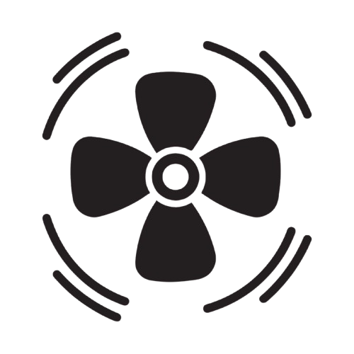
Servo Motor
Housing Unit
Using alternatives like servo motors as they are more precise.
Redesign the housing to align with modern vehicle interiors.
Product Enhancements
Expanded Motion
Improved Ventilation
Add a third motor for full north hemispherical rotation.
Add ventilation to manage motor heat and ensure durability.

Slide 42
Acknowledgments
Alex Blinder
Provided valuable guidance on how to approach this project.
Zoe Mooneyhan (Research and instruction librarian)
Helped us find resources from the library.

Slide 43

Questions?

Slide 44

Demonstration Time!

Slide 45
References
Allied Market Research. (2024). Car sharing market by service type, vehicle type, and application: Global opportunity analysis and industry forecast, 2023-2032. https://www.alliedmarketresearch.com/car-sharing-market-A07125
National Household Travel Survey. (2022). 2022 National Household Travel Survey summary of travel trends. Oak Ridge National Laboratory. https://nhts.ornl.gov/assets/2022/pub/2022_NHTS_Summary_Travel_Trends.pdf
Nationwide Disability Representatives. (n.d.). Avoid blind spot collisions. https://www.nationwidedisabilityrepresentatives.com/blog/avoid-blind-spot-collisions/#:~:text=According%20to%20the%20National%20Highway,year%20in%20the%20United%20States
European Patent Office, Method for controlling automatically for car rear view mirror employing driver's eye location and apparatus thereof. (2020). Patent KR102135305B1:Description.https://worldwide.espacenet.com/publicationDetails/description?CC=KR&NR=102135305B1&KC=B1&FT=D&ND=&date=20200717&DB=EPODOC&locale=
Karvir, S. (2023). Automatic Adjustable Rear-View Mirror Using Servo Motor and Arduino for Bikes. International Journal for Research in Applied Science and Engineering Technology. https://doi.org/10.22214/ijraset.2023.57169
Rota, F., & Stefano, L. (2017). Automatically adjustable rear mirror based on computer vision. 2017 International Conference of Electrical and Electronic Technologies for Automotive, 1-7. https://doi.org/10.23919/eeta.2017.7993218
Blincoe, L., Miller, T., Wang, J.-S., Swedler, D., Coughlin, T., Lawrence, B., Guo, F., Klauer, S., & Dingus, T. (2023, February). The economic and societal impact of motor vehicle crashes, 2019 (Revised) (Report No. DOT HS 813 403). National Highway Traffic Safety Administration. The Economic and Societal Impact of Motor Vehicle Crashes, 2019 (Revised) (dot.gov)
Safety first: car crashes, innovation, and why federal policy should prioritize adoption of existing technologies to save lives - CR Advocacy. (2020, June 28). CR Advocacy. https://advocacy.consumerreports.org/research/cr-safety-first-car-crashes-innovation-federal-policy-study/
Abe, K., Tadakuma, K., & Tadakuma, R. (2021). ABENICS: Active ball joint mechanism with three-DoF based on spherical gear meshings. IEEE Transactions on Robotics. Retrieved from https://doi.org/10.1109/TRO.2021.3070124

Slide 46
References Cont.
Rouse, M. (n.d.). Microcontroller. TechTarget IoT Agenda. Retrieved October 3, 2024, from https://www.techtarget.com/iotagenda/definition/microcontroller
Hotjar. (n.d.). Eye tracking. Hotjar Conversion Rate Optimization Glossary. Retrieved October 3, 2024, from https://www.hotjar.com/conversion-rate-optimization/glossary/eye-tracking/
M. Shawky (2020), "Factors affecting lane change crashes", IATSS Res., vol. 44, no. 2, pp. 155-161, Jul. 2020. https://www.sciencedirect.com/science/article/pii/S0386111219300020
Valentine, Ashlee (2024); Smith, Kelly Anne (2024). Car Ownership Statistics 2024, Forbes Advisor, March 2024. https://www.forbes.com/advisor/car-insurance/car-ownership-statistics/
Survey/Program: American Community Survey Year: 2022 Estimates: 5-Year Table ID: DP04 Source: U.S. Census Bureau, 2018-2022 American Community Survey 5-Year Estimates
Raspberry Pi Foundation. (2023). Raspberry Pi: Camera documentation. Raspberry Pi. https://www.raspberrypi.com/documentation/accessories/camera.html
Raspberry Pi Foundation. (2023). Raspberry Pi: Specifications. Raspberry Pi. https://www.raspberrypi.com/documentation/computers/raspberry-pi.html
Greartisan Store, Amazon (2024). Greartisan DC 12V 10RPM Gear Motor 37mm Diameter Gearbox https://www.amazon.com/Greartisan-Electric-Reduction-Centric-Diameter/
Farnell (2024). 3mm LED Datasheet. https://www.farnell.com/datasheets/1626756.pdf
STMicroelectronics (2024) L293D Push-Pull Four Channel Drivers with Diodes. https://www.st.com/en/motor-drivers/l293d.html
Mouser Electronics. BCM2711 https://www.mouser.com/c/embedded-solutions/computing/single-board-computers/?processor%20type=BCM2711&srsltid=AfmBOoqubikgt8DDLqpXl2IOnmWyuWNTJ1DhlnVO81pf9ozFwo7dw0vg
ZDNet. "Raspberry Pi Alternative: New Odroid C4 Undercuts 4GB Raspberry Pi 4 by 5%." ZDNet, 1 June 2020, www.zdnet.com/article/raspberry-pi-alternative-new-odroid-c4-undercuts-4gb-raspberry-pi-4-by-5/.
Mouser Electronics. L293D Motor Driver https://www.mouser.com/ProductDetail/STMicroelectronics/L293D?qs=gr8Zi5OG3MgMJ1ICDzLQbg%3D%3D
ULINE: Power Supply https://www.uline.com/Product/Detail/S-15608/Batteries/Duracell-Procell-9V-Alkaline-Batteries

Slide 47
References Cont.
Mouser Electronics: USB 3.0 Port https://www.mouser.com/ProductDetail/GCT/USB1100-30-A?qs=KUoIvG%2F9IlYMwAnnOCZOvw%3D%3D
Mouser Electronics: Micro HDMI Port https://www.mouser.com/ProductDetail/Yamaichi-Electronics/PKS019-4011-0?qs=6DDkx98%252BHnB4M72oyP%252BmZw%3D%3D
Mouser Electronics: Ethernet Port https://www.mouser.com/ProductDetail/Pulse-Electronics/J0006D01BNL?qs=Lrve3rxDCt%2F1lZUUYgtZhg%3D%3D
Mouser Electronics: Breadboard https://www.mouser.com/ProductDetail/DFRobot/FIT0096?qs=sGAEpiMZZMu%252BmKbOcEVhFcmX8AApVjboayDYXn1z99r%252Bv3XwBVNlZg%3D%3D
Uxcell: 6V Micro Gear Motor https://www.uxcell.com/10rpm-electric-geared-motor-micro-speed-reduction-motor-gear-box-with-terminals-p-1209800.html
Jiang, X., et al. "Designing a User-Centric In-Car Interface: A Case Study on Rear-View Mirror Adjustment." Transportation Research Part F: Traffic Psychology and Behaviour, vol. 38, 2015, pp. 153-162,https://www.sciencedirect.com/science/article/abs/pii/S1369847815001606

Slide 48

Thank You!

